Slide 1
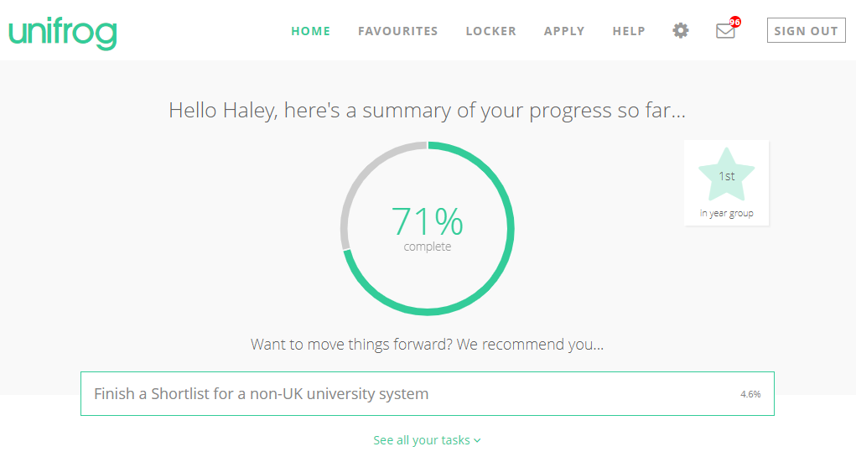
VIDEO - Introduction to Unifrog for Y10-11 / S3-4
Notes:
Teachers’ notes
Video – 13 minutes – Audio required
Here’s a handy video taking KS4/Y10-11/S3-4 students on a tour of the platform! Holding Ctrl and clicking the image will take you to the Loom website to play the video.

Slide 2
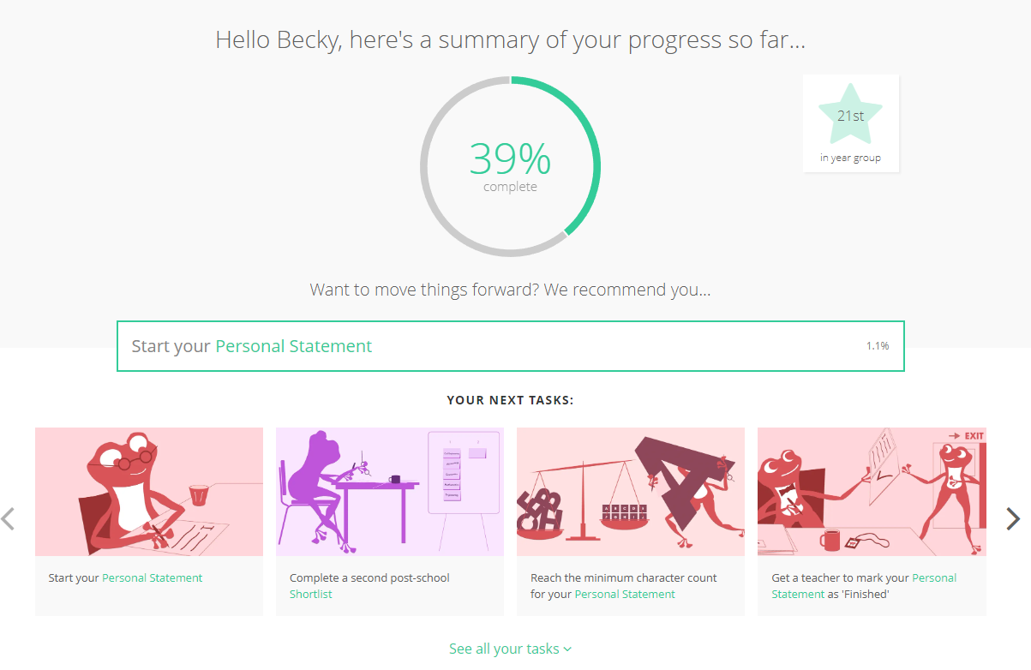
The opening page of Unifrog after you sign in.
For work experience we are not looking at the % it uses here.
You increase this my completing the different tasks and quizzes.
Work Experience is just one part of that.
SCROLL DOWN

Slide 3
To help you decide what you might like to do for work experience or even after Highfields complete the quizzes to build up a profile of who you are.
Do this after you have looked at the ‘Placements’ tool.
SCROLL DOWN

Slide 4
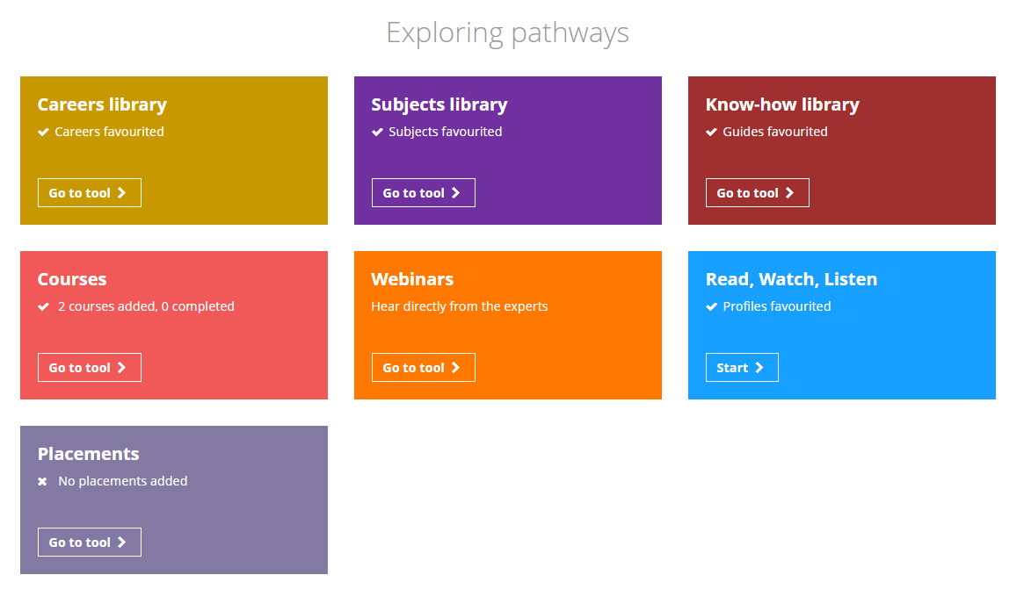
When you reach the ‘Exploring Pathways’ section. STOP.
HERE is the placements tool.
Click go to tool…

Slide 5
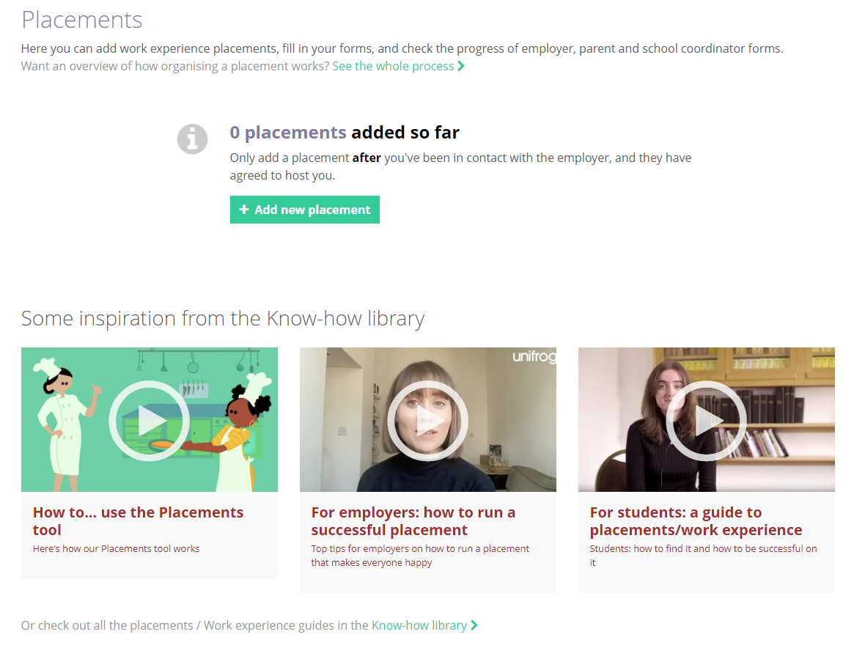
Adding a placement -
Here is where you start the work experience process on Unifrog.
There are videos to help you and give you advice here if you need.
Click ‘+Add new placement’

Slide 6
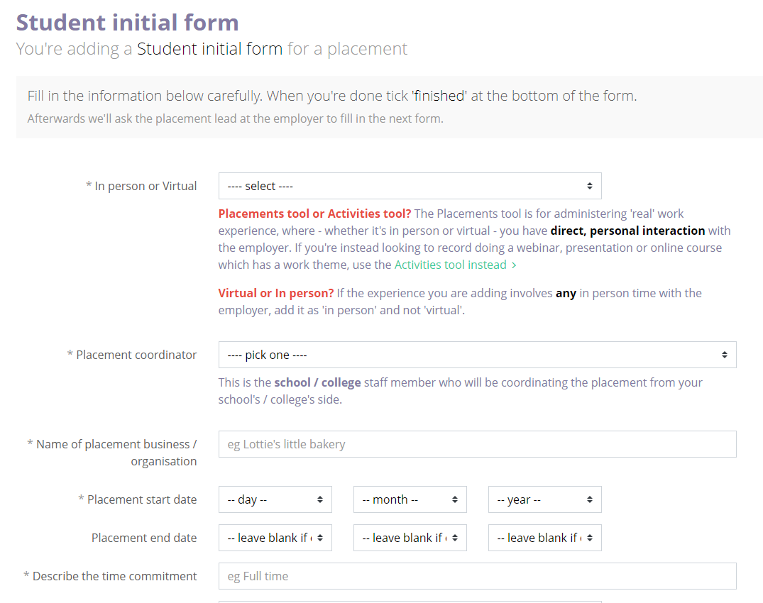
Adding details -
Here you can see the information you will need to add once you have agreed with the employer that you can complete your work experience with them.
This is listed on the next slide too. (and in your booklet you were given, and on SMH)

Slide 7
Checklist
– information you need from the company/ employer for the initial form
Do they have employer liability insurance
Will the placement be in person or virtual
The name of the Company/ Business
The start and end dates you will be there
The time of day/work hours you will be there
The address of where you will be working
The name of the person at the company who will lead your placement (who should school talk to)
Their contact email
Their contact number
Notes:
This will be in the information sent out before Christmas too.

Slide 8
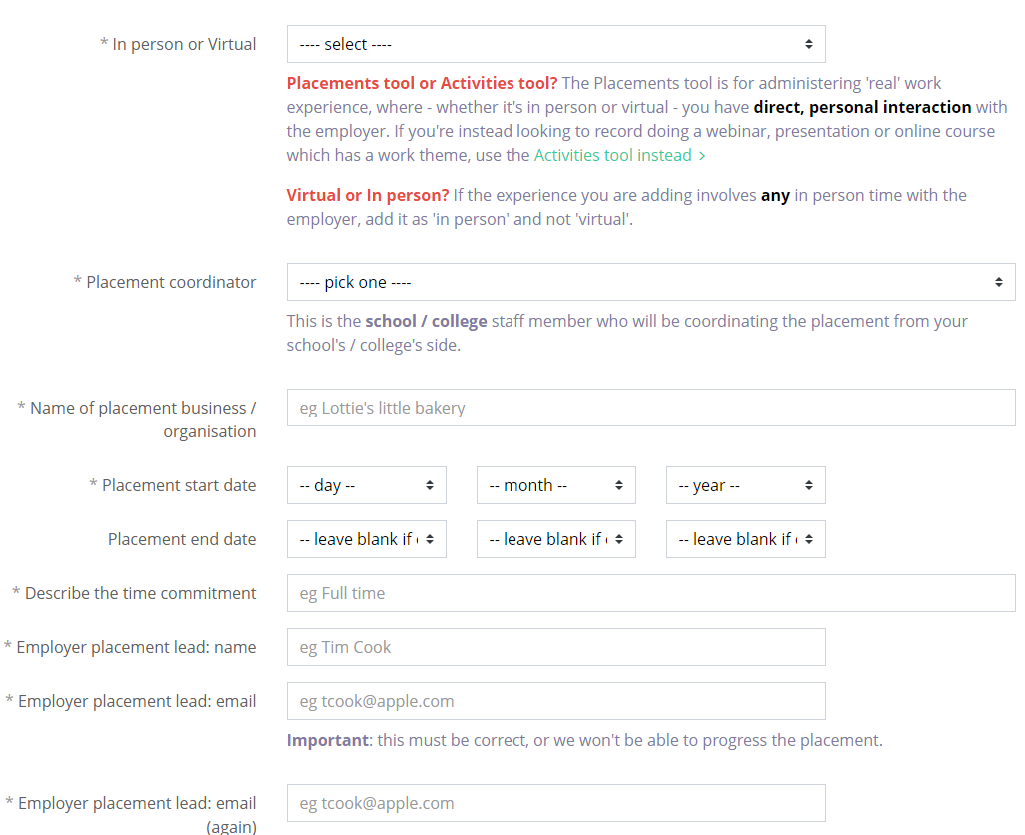
Make sure you fill these details in correctly.
This is the email that the next form will be sent to.
It must be to the company or employer you will work for.

Slide 9
You need to make sure you are completing steps 1 and 2 now. Some companies are already full.
Action | Researching, contacting and agreeing a placement can take a bit of time. Make sure you start early to get the best chance of securing a placement you would choose!
1. Find and agree a placement with an employer
2. Add placement on Unifrog - Student initial form | Suggested deadline = 16th February Final Deadline= 22nd March
3. Automatic email is sent - Employer initial form | The employer needs time to complete this it may be a couple of weeks.
4. Automatic email is sent - Parent / guardian agreement | Parents will want to check the details and make sure they are happy so they will need time for this.
5. Placement coordinator permission | There are a lot of students in the year group so school will need time to check through all the details of each one and give permission.
Work Experience! – 1st July to 5th July

Slide 10
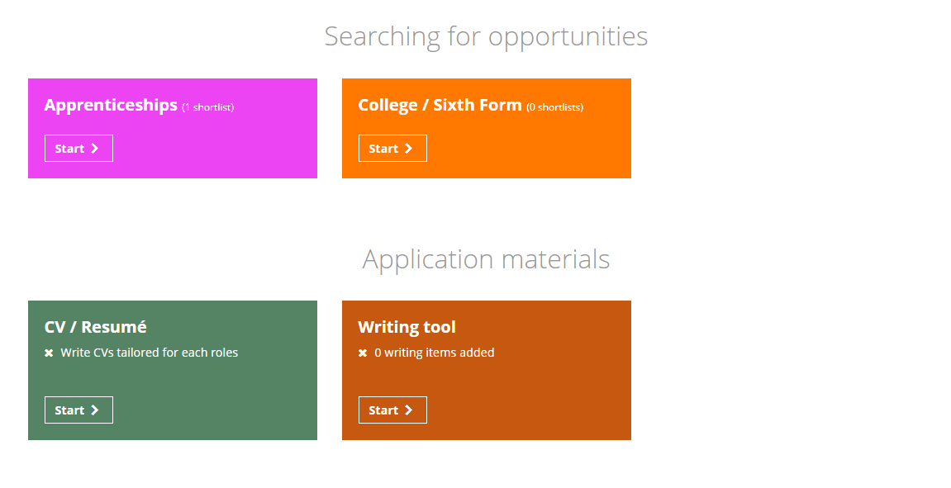
Back to Unifrog…
These are the other sections of Unifrog.
You don’t need them for Work Experience but they might help you in the future thinking about your next steps.

Slide 11
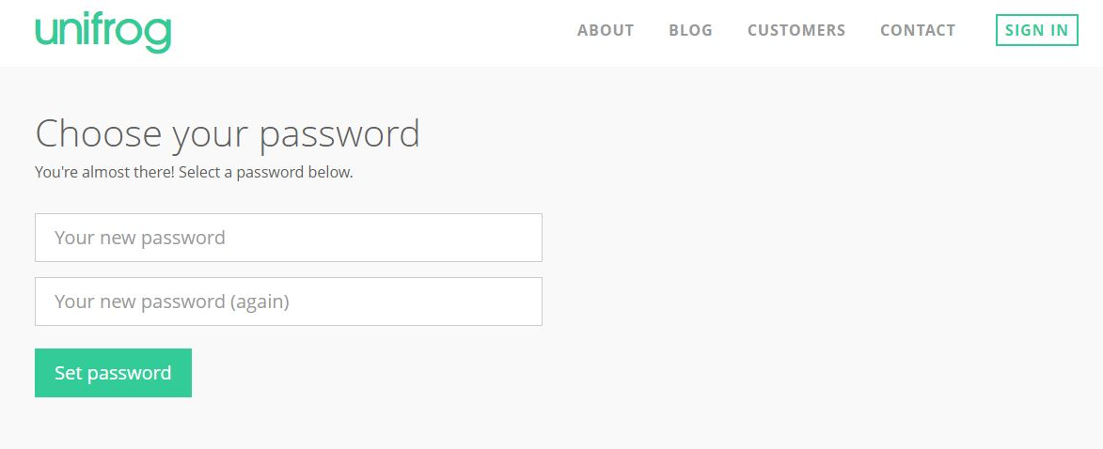
Creating your account
A link has been sent to your school email address (please check your junk/spam mailboxes).
Click the link and follow the instructions.
Create a memorable password and make a note of your password!

Slide 12
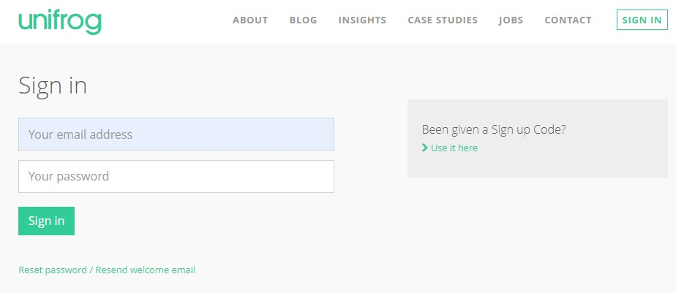
Cant find the email - Access your accounts
Follow the instructions as if you have forgotten your password - hit the link to reset.
Now check your school email address (please check your junk/spam mailboxes).

Slide 13
Link to Unifrog
Sign In - Unifrog

