Slide 1
A Level French at Highfields
Here’s what our current Year 13 students have to say…..

Slide 2
Why French?
develop skills
demonstrate the ability to communicate effectively
opens doors
can be studied in conjunction with any subject

Slide 3
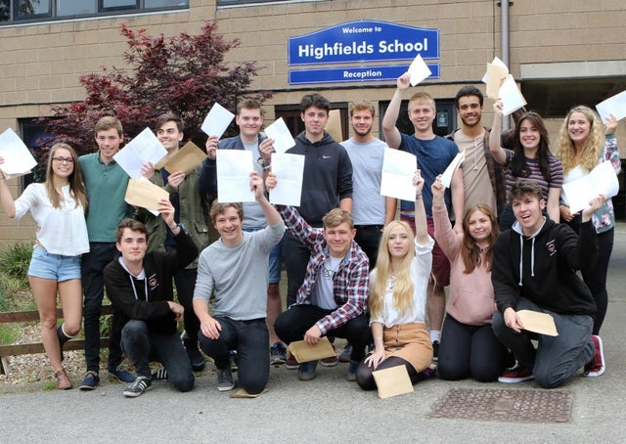
Why Highfields?
supportive teachers
welcoming and friendly
great atmosphere

Slide 4
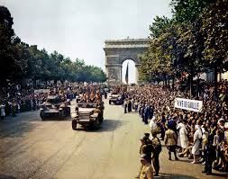
What do you study in French? Click on the speaker icons to hear what our students have to say…
Favourite topics
Why I like the Independent Research Project

Slide 5
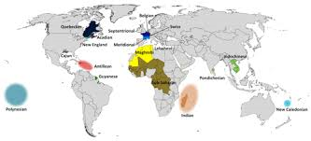
What do you do outside of lessons?
one 50 minute lesson with our French assistant

Slide 6
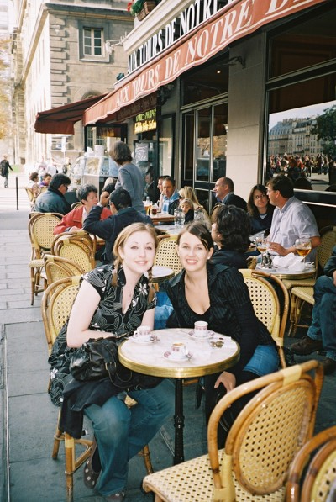
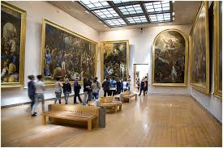
Trips

Slide 7
Step between GCSE and A Level
Class sizes
Homework
Independence
Sharing work and ideas
Relationship with classmates

Slide 8
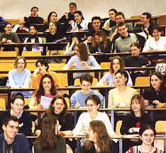
What next?

