Slide 1
A Level English Literature

Slide 2
What is English Literature?
English Literature is the study of written works in the English Language.
You are currently studying this subject at GCSE.

Slide 3
How is it different to GCSE?
We explore how our set texts fit into literary genres.
You complete two pieces of coursework.
The majority of the questions on the exam are statement-based, where you are asked to explain to what extent you agree with the statement in relation to the set text.

Slide 4
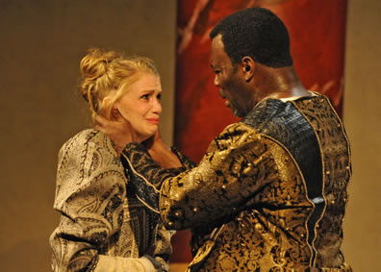
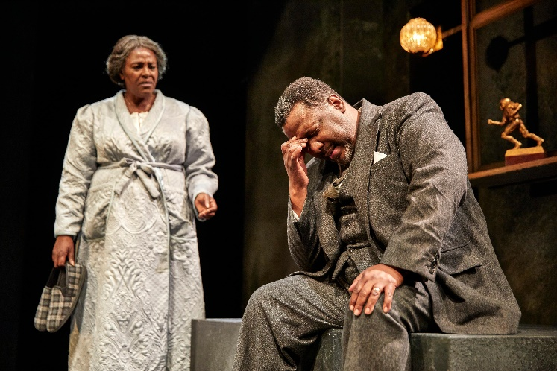
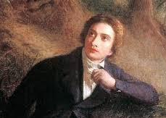
Aspects of tragedy
For this exam paper, we study three set texts:
Othello – William Shakespeare
Death of a Salesman – Arthur Miller
A selection of narrative poems by John Keats

Slide 5
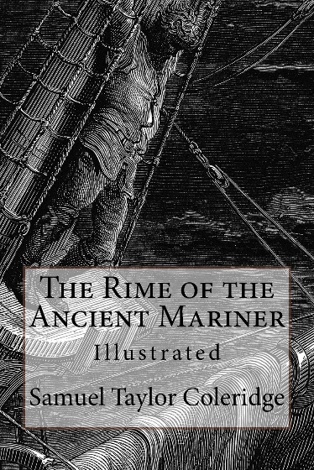
Elements of crime writing
For this exam paper, we study three set texts, and prepare to answer a question on an unseen extract:

Slide 6
What careers can it lead to?
Journalist
Digital copywriter
Author
Teacher

