Slide 1
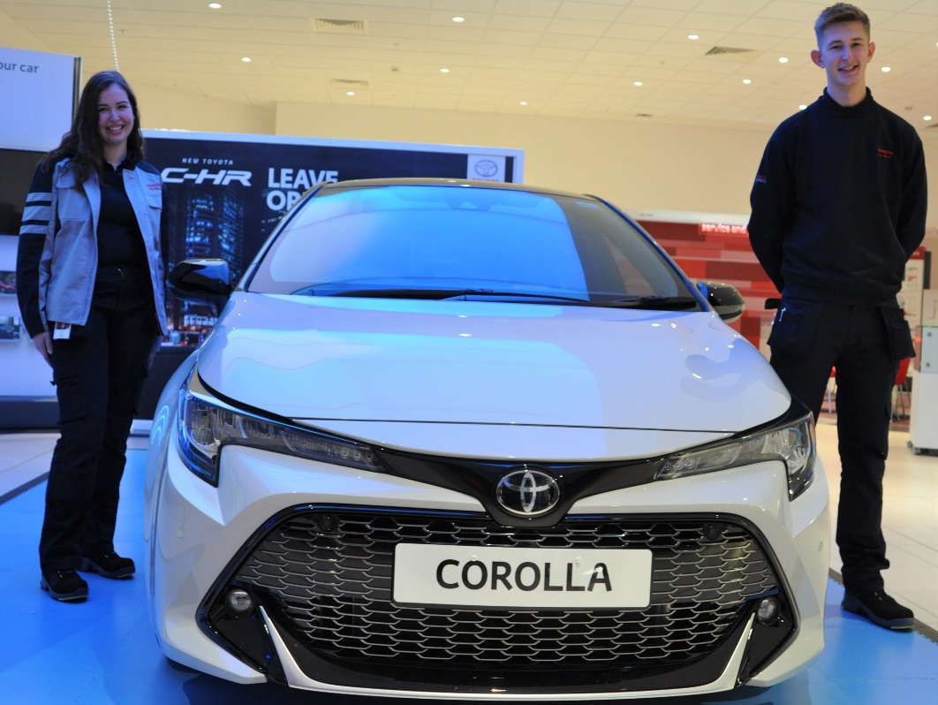
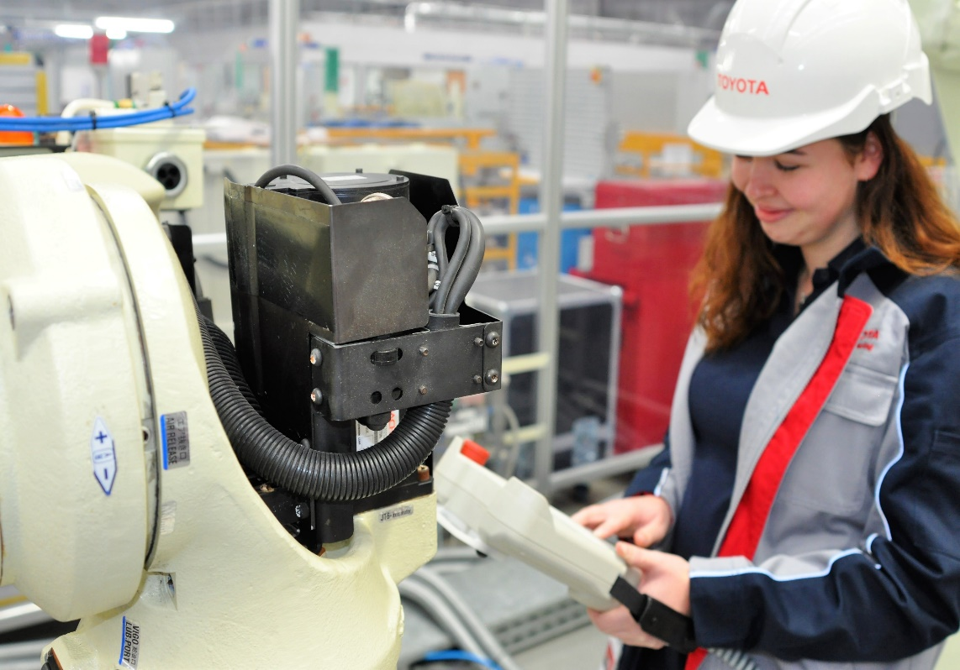
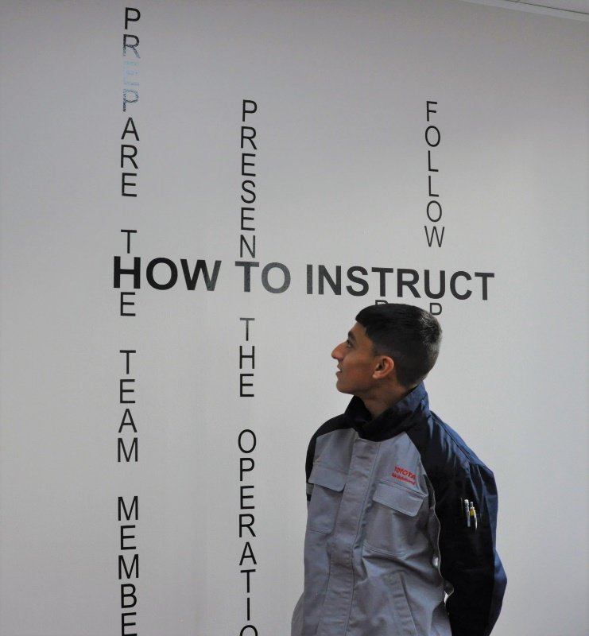
with Toyota Motor Manufacturing (UK) ltd.
Apprenticeship Opportunities
https://recruitment.toyotauk.com/
Notes:
Welcome from Emma

Slide 2
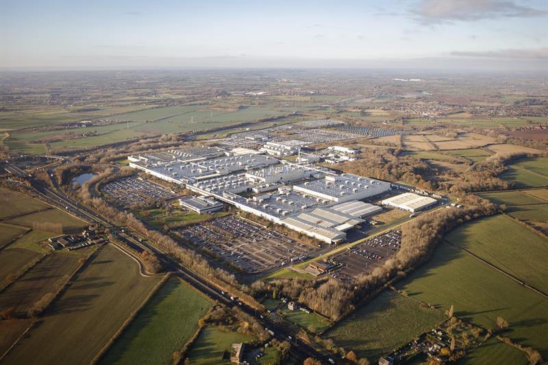
Where are we located?
About us
Burnaston plant: What we do
Sole European manufacturing plant for Corolla Hatchback
Sole Global manufacturer for Corolla Touring Sports
Exporting to 34 countries worldwide
We produce around 150,000 vehicles per year
Burnaston, Derbyshire
vehicle manufacturing
Start of production Dec 1992
2,629 employees (incl. 383 agency)

Slide 3
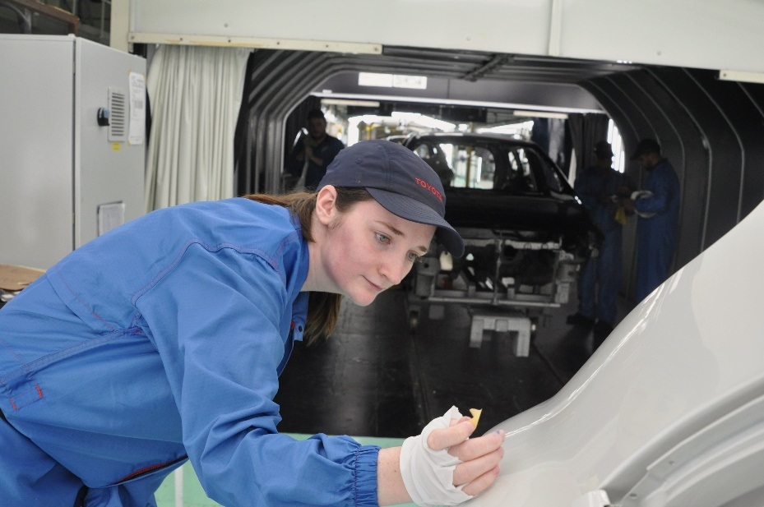
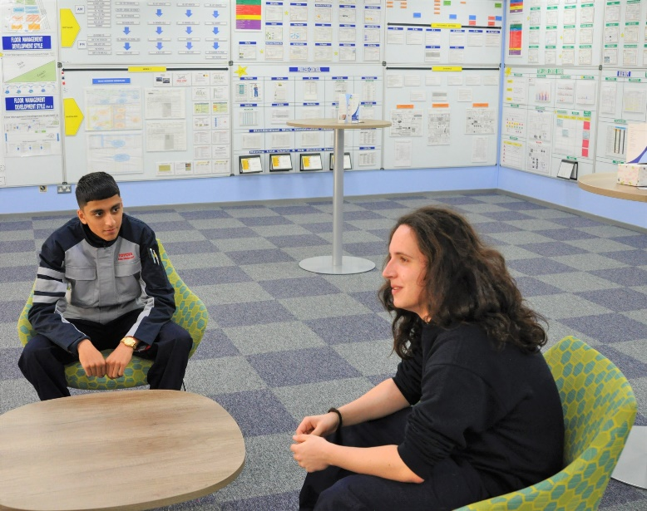
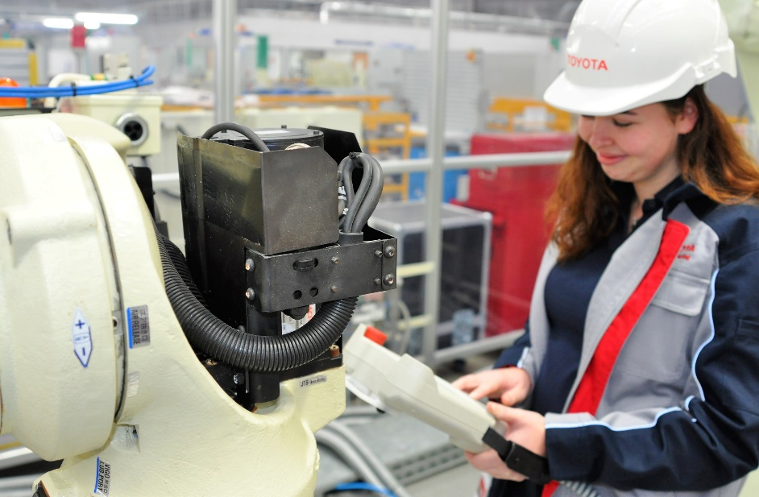
What apprenticeship schemes do we offer?
Production Apprenticeship (12 months)
Maintenance Apprenticeship (44 months)

Slide 4
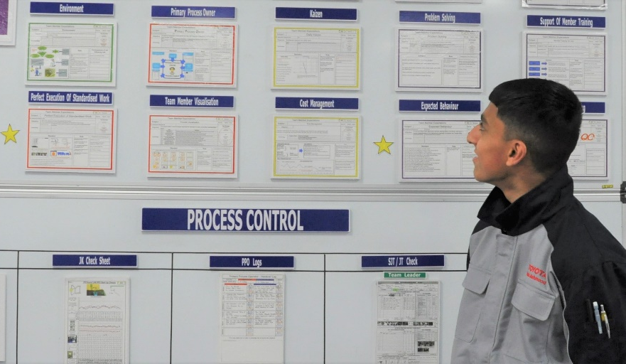
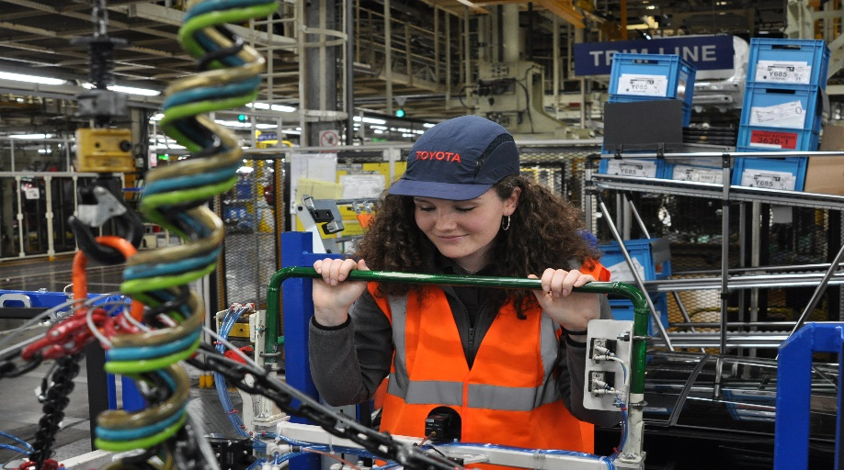
Production Apprenticeship
What is it?
This is an exciting 12 month training period, where you will develop the practical skills and theory to become a member of our fantastic production team working on our fast paced Corolla line.
You will learn how to carry out production processes safely, efficiently and to outstanding quality
Location – Burnaston, Derby
Qualification – Upon successful completion you will gain a level 2 diploma in manufacturing!
Salary: £13,391 (increasing to £22,687 upon completion of scheme)
Hours - 39 hours per week
Start Date – September 2021
What will you do?
You will carry out three different production placements
You will also undertake classroom and off the job hand skills training as well as time spent away from site on further development activities (transport provided)
You will learn about the Toyota Production system and our core philosophies of continuous improvement and respect
Upon completion of the 12 months, you will be placed in one of 7 departments, and be a permeant team member here at TMUK!

Slide 5
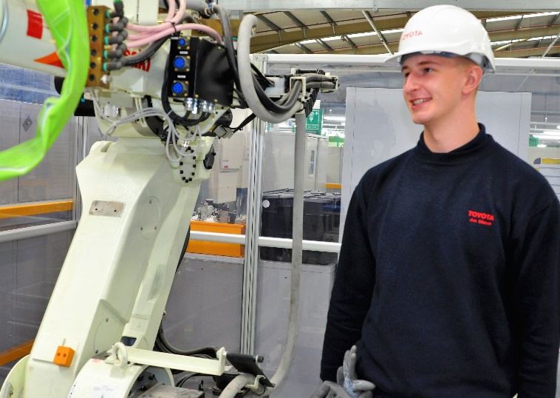
Maintenance Apprenticeship
What is it?
A maintenance member develops and maintains equipment so our manufacturing team can produce the Toyota Corolla to perfect standards every time, on time.
Training in our Burnaston academy, you will learn and develop the technical skills and theory required to become a competent member of our maintenance team.
Some skills you will learn include welding, machining, hand tool use, robotics and electronics!
Hours: 39 hours per week
Location: Burnaston, Derby and Deeside, North Wales
Qualifications required: to apply you must have or be expecting 4 GCSE at grade ‘4’ or above including Maths, English and Science (or equivalent).
STAGE 1- For the first 22 months, you will train mainly in our onsite academy, with some placements within Toyota maintenance and manufacturing departments.
STAGE 2- For the final 22 months, you will be mainly based in a production department at Toyota, learning how to practically apply and develop your new skills in a real work environment!
Salary: £13,391 rising with annual increments to £33,476 upon successful completion off 44 month scheme
Start date – September 2021
You will work towards recognised level 3 maintenance qualifications!

Slide 6
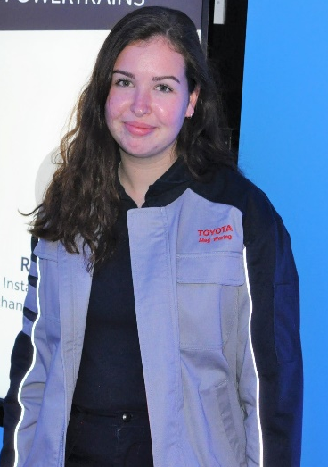
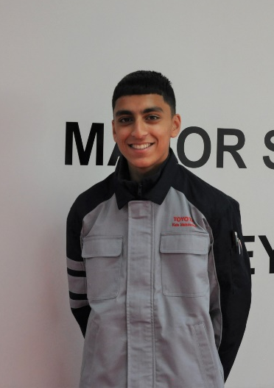
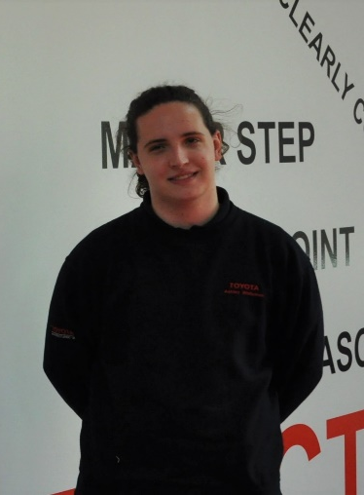
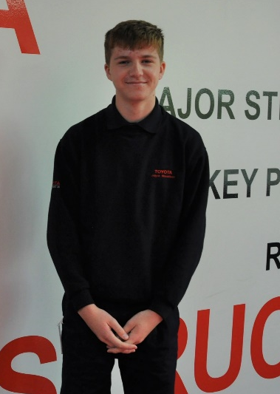
Our current apprentices
I liked the recruitment process, I felt very comfortable within the company. I would encourage other females to apply - I felt welcomed from the start. I enjoy that there is a real mix of industry, college and practical work incorporated throughout the course.
Kais
You are developing in a friendly environment, where everybody respects one another. In the short time I have been here, I already feel as if I am part of the team.
Megan
Joe
Kareem
By the end of my first day here, everybody knew each other and we’ve all bonded really well! I am excited at the prospects of progression that the production apprenticeship will open doors to in my future.
Everybody is treated equally at Toyota, you feel as if you are part of the Toyota family from the beginning!
Ashley
Jolyon
To find out more or apply, visit https://recruitment.toyotauk.com/

Slide 7
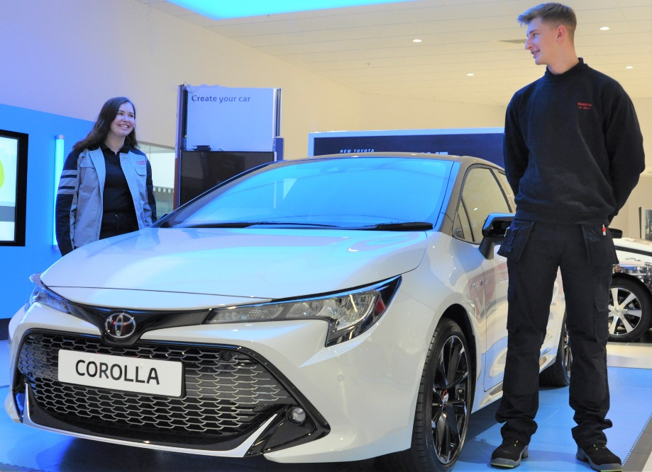
Open Evenings
If you are interested in attending one of our open events, please ensure you book your place at https://recruitment.toyotauk.com/ Booking is essential.
Production Apprenticeship Dates
Tuesday 10th November 2020
Thursday 19th November 2020
Come to our Burnaston site to meet some of our team, and experience where you could be training and working! We will be on hand to answer any questions you may have.
Maintenance Apprenticeship Dates
Monday 9th November 2020
Wednesday 18th November 2020

Slide 8
Thank you!
To find out more, or apply to one of our apprenticeship opportunities, visit https://recruitment.toyotauk.com/
If you have any questions at all, please e-mail recruitment@toyotauk.com

